Slide 1



BPO_Dashboard
View in Power BI
Last data refresh:
3/4/2023 11:15:43 AM UTC
Downloaded at:
3/4/2023 11:20:33 AM UTC

Slide 2
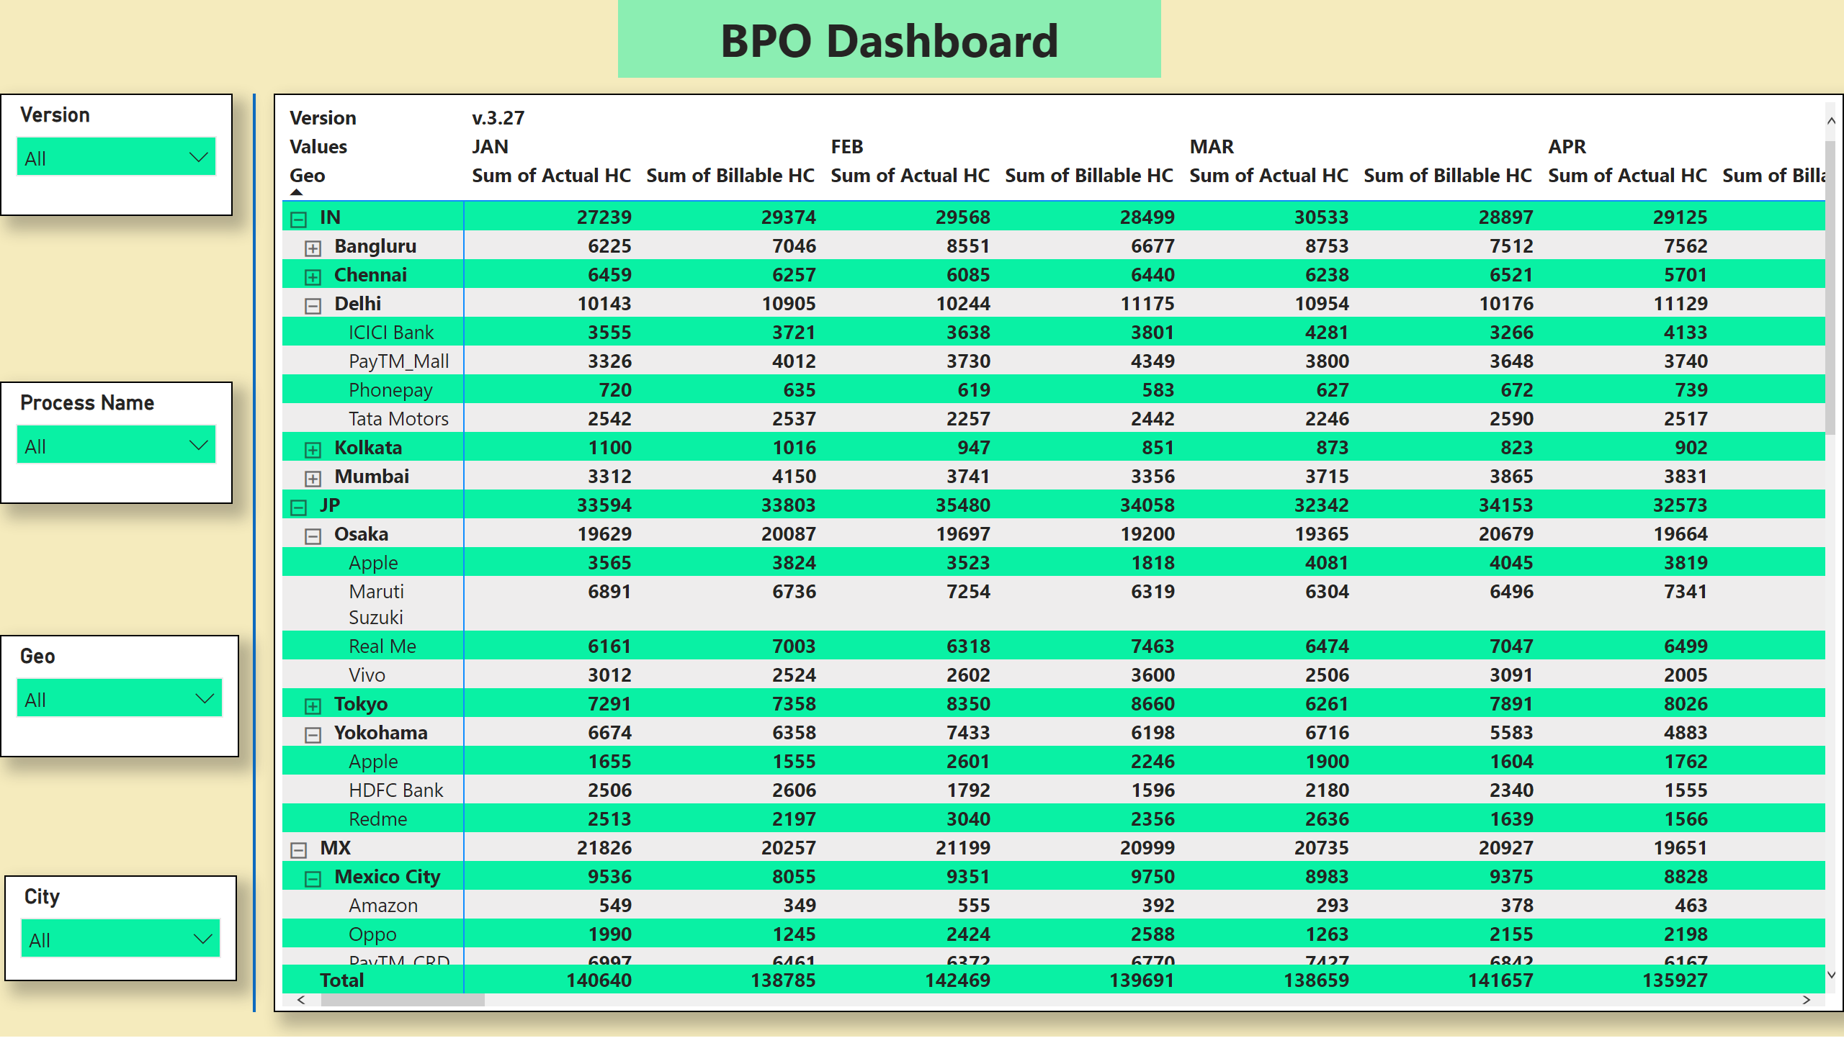
Absolute HC
Notes:
pivotTable
No alt text provided
slicer
No alt text provided
slicer
No alt text provided
slicer
No alt text provided
slicer
No alt text provided
shape
No alt text provided
textbox
No alt text provided

Slide 3
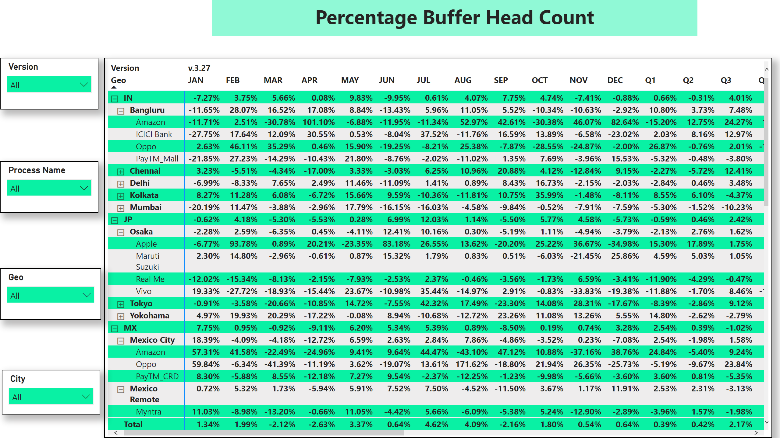
Buffer HC
Notes:
pivotTable
No alt text provided
slicer
No alt text provided
slicer
No alt text provided
slicer
No alt text provided
slicer
No alt text provided
textbox
No alt text provided

